Slide 1
Interprofessional Practice:
Staff and Clinician Collaborative Practice Assessment
Barbara J. Burgel, RN,. PhD, FAAN, Gerri Collins-Bride, RN, NP, MS, FAAN, Sherri Borden, RN, ANP, MS, Lewis Fannon, RN, ANP, MS, & Bernadette Navarro-Simeon, PhD
UCSF School of Nursing, Department of Community Health Systems &
Progress Foundation, San Francisco, CA.

Slide 2
1. Describe the Interprofessional Primary Care Outreach to Persons with Mental Illness, a partnership between UCSF School of Nursing and Progress Foundation. 2. Evaluate changes in collaboration between staff and clinicians over two years of enhanced resources expanding interprofessional practice and group team building in 10 programs.
Aims:

Slide 3
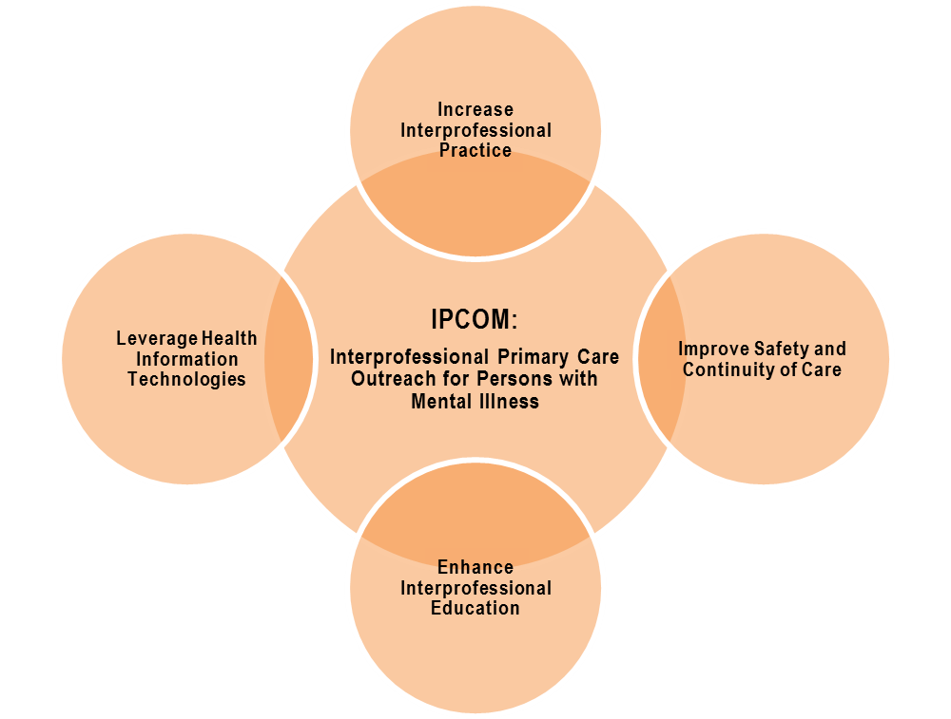
IPCOM

Slide 4
Community Partnership
Progress Foundation has been providing mental health services in San Francisco since 1969 in 13 residential treatment facilities in San Francisco and Napa
Clients have complicated medical, psychiatric, and substance abuse issues
Partnership with the UCSF School of Nursing began in 1994 and currently provides primary care services to those with serious mental illness (SMI)
Interprofessional collaboration began in 2013, funded by HRSA.

Slide 5
IPCOM Model Components
Interprofessional (IP) teams consist of a nurse practitioner, psychiatrist/psychiatric nurse practitioner, pharmacist, dentist, behavioral health staff, and IP students.
Student QI projects
Development of communication systems and infrastructure to facilitate collaboration across disciplines and clinical sites that previously operated in parallel fashion.
Warm handoffs at end of shift
Team huddles with pharmacist
Electronic health records

Slide 6
Client Demographics, 2015
n=1,435 unique patient visits | Numbers/Mean | Percent/SD
Mean age | 42.38 | 11.80
Gender Male Female Transgender | 890 482 53 | 62% 34% 4%
Race/Ethnicity Caucasian African American Hispanic/Latino Asian/Pacific Islander American Indian/Alaskan Native Mixed/Other | 614 487 169 90 20 18 | 44% 35% 12% 6% 1% 1%
Homelessness/in shelter, prior to admission | 833 | 58%
Smoker | 834 | 58%
ETOH, marijuana, stimulants or opiates | 655 | 46%
Years of education | 12.39 | 2.15
Notes:
No regular primary care provider, n=433, 30%
Uninsured rate low: 5/1%
Primarily MediCal 82.3%
Physical trauma/abuse during lifetime

Slide 7
Psychiatric Diagnosis at Admission, 2015
Percentage of Principal Admitting Psychiatric Diagnosis

Slide 8
Medical Diagnosis at Admission, 2015

Slide 9
Methods
All team meetings were held twice/year.
All staff and clinicians in 10 programs were asked to complete the Collaborative Practice Assessment Tool (CPAT) (57 items) up to 4 time points.
CPAT includes 8 subscales: Mission, Relationships, Leadership, Roles, Communication, Community Linkages, Decision Making and Patient Involvement.
Answers ranged from 1 (strongly disagree) to 7 (strongly agree).

Slide 10
Interprofessional Interventions
Group training in interprofessional team building for all clinicians and staff in the acute diversion units
Co-presence of medical and psychiatric clinicians on same day
Warm handoffs between clinicians and staff
Once/month huddles at each program with pharmacist
Pilot of electronic medical records within behavioral health system
Psych NP and AGNP NP Student “test of change” quality improvement projects presented at biannual team meetings
HIV Screening, Tobacco Talks, Transitional Age Youth Services, Staff MI Training, and Dental Health Screening

Slide 11
Methods
82 CPAT surveys were completed in years 1 and 2
72 surveys with complete data were used for this analysis: 34 baseline surveys over 4 dates and 39 repeated surveys over 3 dates
Clinicians (n=7 completed 21 surveys) included physicians, pharmacy, and nursing
Behavioral Health Staff (n=27 completed 51 surveys) included program directors and counselors
Group subscale means were compared for both roles to determine change over time. A two way ANOVA was conducted with two ‘between subjects’ factors: baseline vs. repeat, and staff vs. clinicians to determine if any group change over time depended on role.

Slide 12
Results: CPAT Domain Subscale Scores By Time
Notes:
CPAT—8 domains, 56 items, self administered;
Answer respondents range from 1 (strongly disagree)-7 (strongly agree),with some reverse coded items.
82 surveys were completed over the 4 dates, and they are not independent observations; 72 are used for this analysis (10 baseline surveys from June 2015 are not reported on this slide). Baseline surveys for this slide were from 3 times points (Feb 2014, July 2014, Jan 2015), with repeat surveys from 3 time points (July 2014, Jan 2015, June 2015)
Of the 72, there are 34 unique individuals (7 clinicians completing 21 surveys; and 27 staff contributing 51 surveys). Respondents may have contributed just one baseline survey and 0 repeats, or could have contributed up to 3 repeat surveys.
CPAT scores showed an overall high level of collaboration amongst all respondents in Mission, Relationships and Client Involvement. There were no significant changes from baseline to repeats.

Slide 13
Results: CPAT Domain Subscale Scores By Roles
Notes:
By roles, all data points (34 baseline surveys over 4 time points, with 39 repeated surveys over 3 time points).
Staff roles included all Progress staff, except for psychiatrists/Psych NPs. Clinicians included Medical NPs, Pharmacist, Dentist and Psychiatrist/NP.
CPAT scores showed an overall high level of collaboration, with high staff and clinician scores in Mission, Relationships and Patient Involvement.
Clinicians (mean 6.64, SD 0.57) had a significantly higher subscale score in Relationships, as compared to staff (mean 6.10, sd 0.97), p=0.019.

Slide 14
CPAT Domain Subscale Scores By Time for Staff
Notes:
When analyzing group change, for staff, there were no significant changes over time, with 7 subscale scores declining from baseline.

Slide 15
CPAT Domain Subscale Scores By Time for Clinicians
Notes:
When analyzing group change, for clinicians, over time, all subscale scores increased from baseline, with Mission [Pre group mean: 5.7 (sd 1.1) to Post group mean: 6.4 (0.46), p=0.049] and Communication [Pre group mean: 5.3 (sd 1.1) to Post group mean: 6.3 (sd 0.62), p=0.013] showing significant changes from baseline.

Slide 16
Communication Subscale: Interaction between Role and Time, p=0.025
 | Staff | Clinicians
Baseline Scores, n=34 | 5.81 (sd .70) n=27 | 5.26 (sd 1.07) n=7
Repeat Scores, n=38 | 5.76 (sd 1.04) n=24 | 6.26 (sd .62) n=14
Total n=72 | 5.78 (sd .87) n=51 | 5.93 (sd .91) n=21
Notes:
When comparing baseline and repeat mean subscale scores for staff vs. clinician roles, clinicians demonstrated significantly more change in Communication when compared to the change scores for staff [For staff: Pre group mean: 5.8 (sd 0.70) to Post group mean: 5.8 (sd 1.04); For clinicians: Pre group mean: 5.3 (sd 1.07) to Post group mean: 6.3 (sd 0.62), p= 0.025]. No other subscale scores showed this interaction effect. Limitation: not independent scores; and numbers are small.

Slide 17
Limitations
Small numbers, 10 programs
Time to effect was different for programs….the acute diversion programs began in year 1, and the transitional programs began at the beginning of year 2.
CPAT is best used as a group planning tool with the goal to tailor interventions to the lower scoring subscales in each residence. This was not done due to resources.
Clinicians were a more stable group over time; there was staff turnover, and hence a need for ongoing team building, with a shared vision, mission and goals.

Slide 18
Lessons Learned
There is a high level of collaboration perceived by both staff and clinicians.
Staff scores remained unchanged over time, whereas clinicians demonstrated significant changes in Mission and Communication.
When compared to staff, the changes in Communication between baseline and repeated surveys by clinicians were significantly greater.
These data will guide IPCOM next steps in team building with staff, sharing these results to gain their input on opportunities for interprofessional development over the next year of the grant.

Slide 19
Acknowledgements
Thank you to the Progress Foundation clinicians and staff who completed the CPAT surveys, and the clients we serve.
Thank you to IPCOM staff, Elizabeth Bartmess-Levasseur, Pat Mejia , and faculty colleague Linda Chafetz, RN, PhD, FAAN
Funding received from HRSA Nurse Education, Practice, Quality and Retention Grant (2013-2016). Grant number UD7HP26047. Gerri Collins-Bride, Project Director

Slide 20
Selected References
Byrnes, V., O’Riordan, A., Schroder, C., Chapman, C., Medves, J., Paterson, M., & Grigg, R. (2012). South Eastern Interprofessional Collaborative Learning Environment (SEIPCLE): Nurturing collaborative practice. Journal of Research in Interprofessional Practice and Education, 2.2, 168-186.
Office of Interprofessional Education and Practice, Collaborative Practice Assessment Tool. Queen’s University, Ontario, Ottawa: Canada. http://meds.queensu.ca/oipep
Paterson, M., Medves, J., Dalgarno, N., O’Riordan, A., & Grigg, R. (2013). The timely open communication for patient safety project. Journal of Research in Interprofessional Practice and Education, 3.1, 22-42.
Saulnier, S., Donnelly, C., O’Riordan, A., Langstaff, C., & Jones, N. (n.d.). Enhancing Interprofessional Collaboration within Stroke Teams: Developing a Continuous Improvement Process. Retrieved from http://www.heartandstroke.on.ca/atf/cf/%7B33C6FA68-B56B-4760-ABC6-D85B2D02EE71%7D/SC_2011_Poster_StrokeStrategy.pdf

